Slide 1
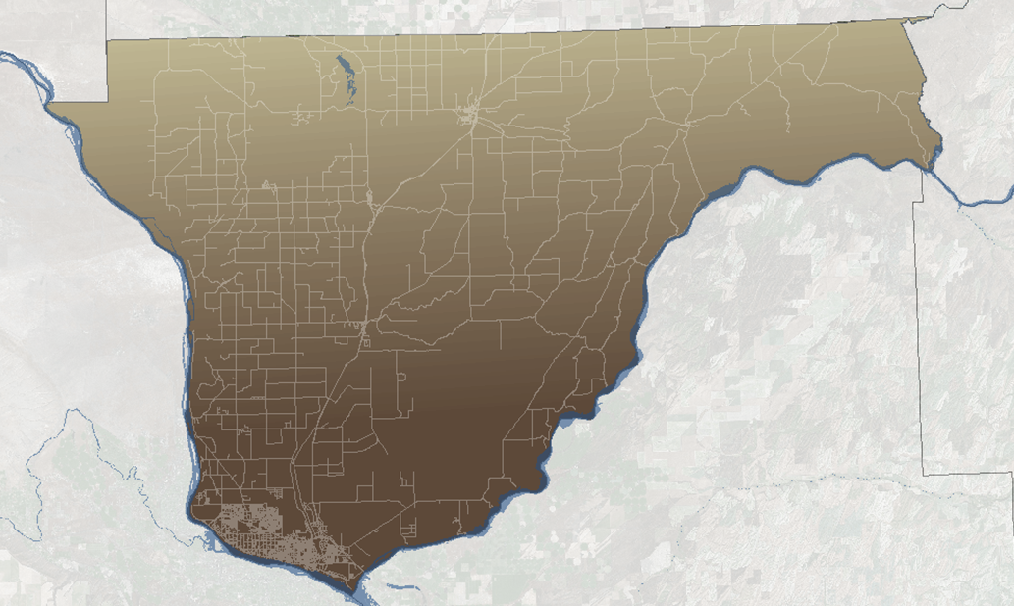
Franklin county comprehensive plan update
Board of County Commissioners Presentation
March 23, 2021

Slide 2
TERMS and acronyms
GMA
UGA
LAMIRD
CFP
CWPPs
Franklin County Comprehensive Plan

Slide 3
Growth Management act
The Legislature adopted the Growth Management Act in 1990
Response to concerns that: uncoordinated and unplanned growth, together with a lack of common goals expressing the public’s interest in the conservation and wise use of our lands, pose a threat to the environment, sustainable economic development, and the health, safety, and high quality of life enjoyed by the residents of this state (RCW 36.70A.060 and 170)
Franklin County Comprehensive Plan

Slide 4
GMA: Urban growth should occur
First in areas already characterized by urban growth that have adequate existing public facility and service capacities to serve such development
Second in areas already characterized by urban growth that will be served adequately by a combination of both existing public facilities & services and any additional needed public facilities and services that are provided by either public or private sources
Third in the remaining portions of the urban growth areas.
(Urban growth may also be located in designated new fully contained communities as defined by RCW 36.70A.350).
Franklin County Comprehensive Plan

Slide 5
URBAN GROWTH AREAS

Slide 6
Urban growth areas
Each County….shall designated UGAs
INSIDE: Growth of an urban nature
OUTSIDE: Only Growth NOT of an urban nature
USAs always encompass Cities
Size based on growth management population projections
Franklin County Comprehensive Plan

Slide 7
Urban growth areas
Counties are responsible for designating, expanding, and reducing UGA boundaries, although they are required to consult with the cities in their determinations
Cities may not annex areas outside of UGAs
Establishing UGAs is a major step under the GMA that local communities take in managing their growth
Franklin County Comprehensive Plan

Slide 8
WHY UGAs?
Protect Rural Character
Reduce conflicts with farming
Foster regional coordination between counties, cities
Accommodate growth
Direct where facilities, investments should be located during the 20-year planning period
Protect natural resource areas
Protect environmentally sensitive areas
Prevent sprawl
Franklin County Comprehensive Plan

Slide 9
Sizing principles
Areas and densities to permit the urban growth projected to occur in the next 20-year period
Assess what is available for realistic development through an inventory
Market and economic factors
What is entitled (preliminary plats approved / zoning / density)
Infrastructure aspects, availability of facilities
Consider critical areas (wetlands, steep slopes, floodplains, etc.)
May not encroach on resource lands
Franklin County Comprehensive Plan

Slide 10
Urban growth
"Urban growth" refers to growth that makes intensive use of land for the location of buildings, structures, and impermeable surfaces to such a degree as to be incompatible with the primary use of land for the production of food, other agricultural products, or fiber, or the extraction of mineral resources, rural uses, rural development, and natural resource lands designated pursuant to RCW 36.70A.170.
A pattern of more intensive rural development, as provided in RCW 36.70A.070(5)(d), is not urban growth. When allowed to spread over wide areas, urban growth typically requires urban governmental services. "Characterized by urban growth" refers to land having urban growth located on it, or to land located in relationship to an area with urban growth on it as to be appropriate for urban growth. "Urban growth areas" means those areas designated by a county pursuant to RCW 36.70A.110.
Franklin County Comprehensive Plan

Slide 11
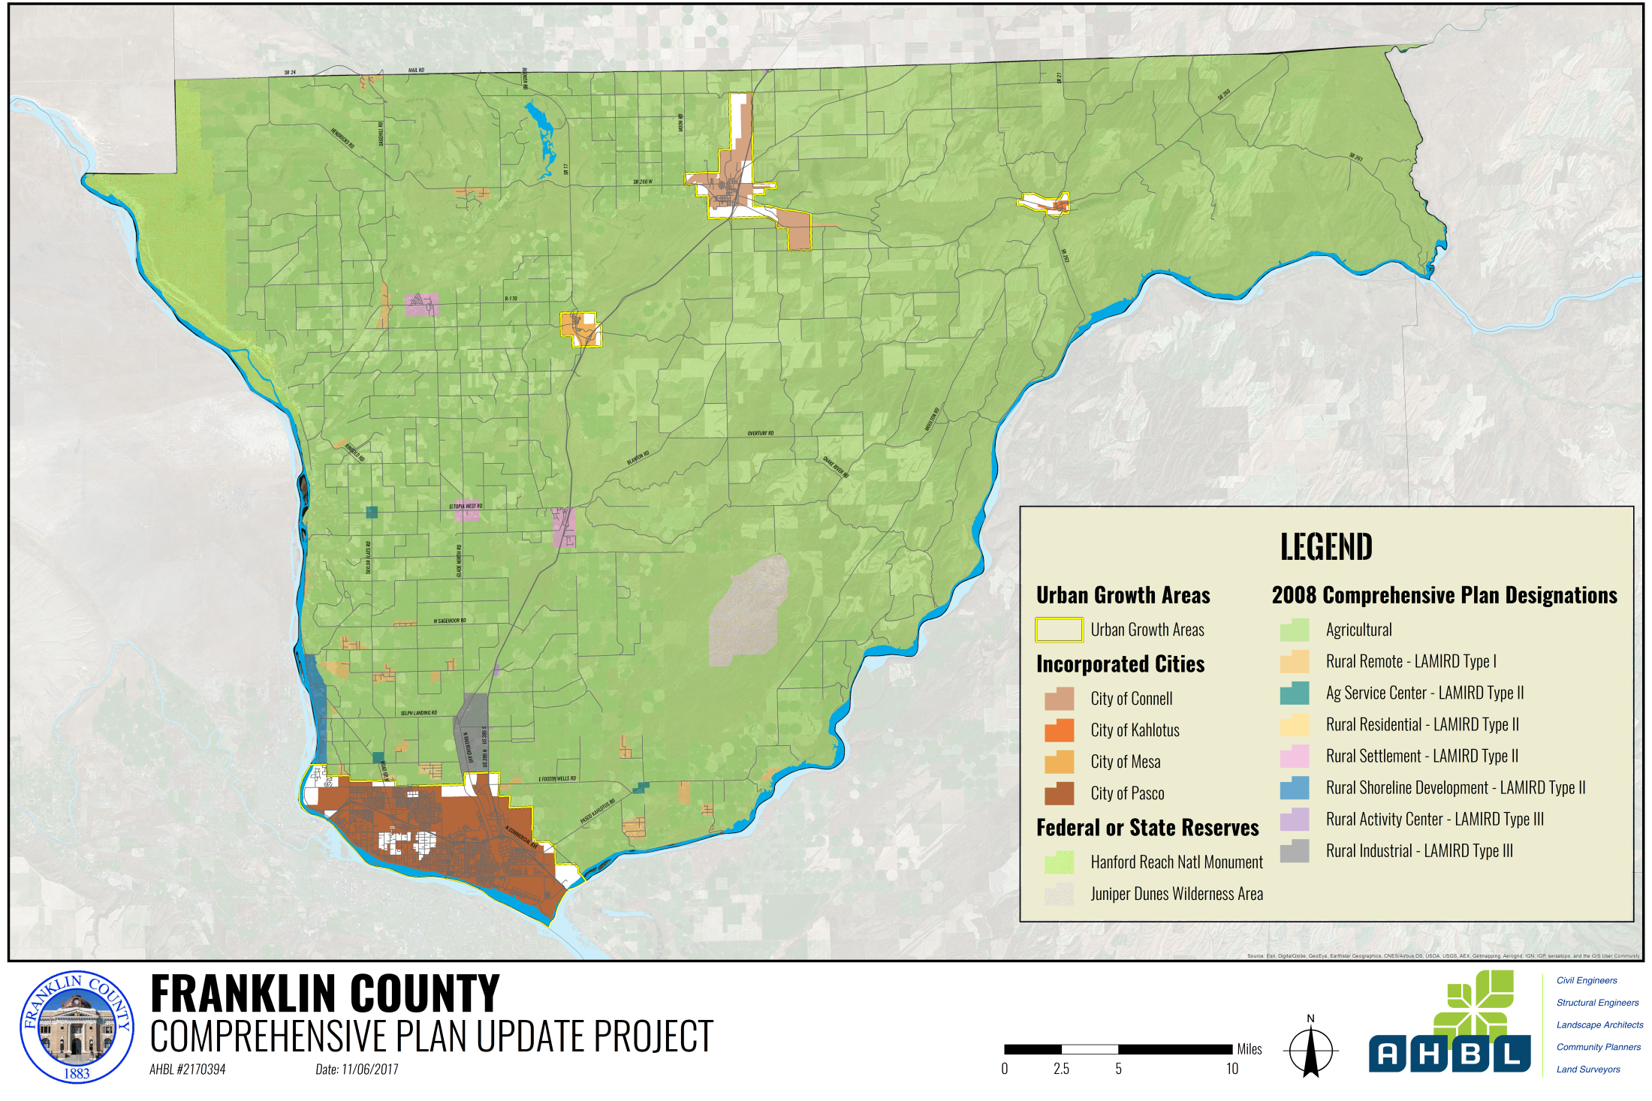
Franklin County Comprehensive Plan

Slide 12
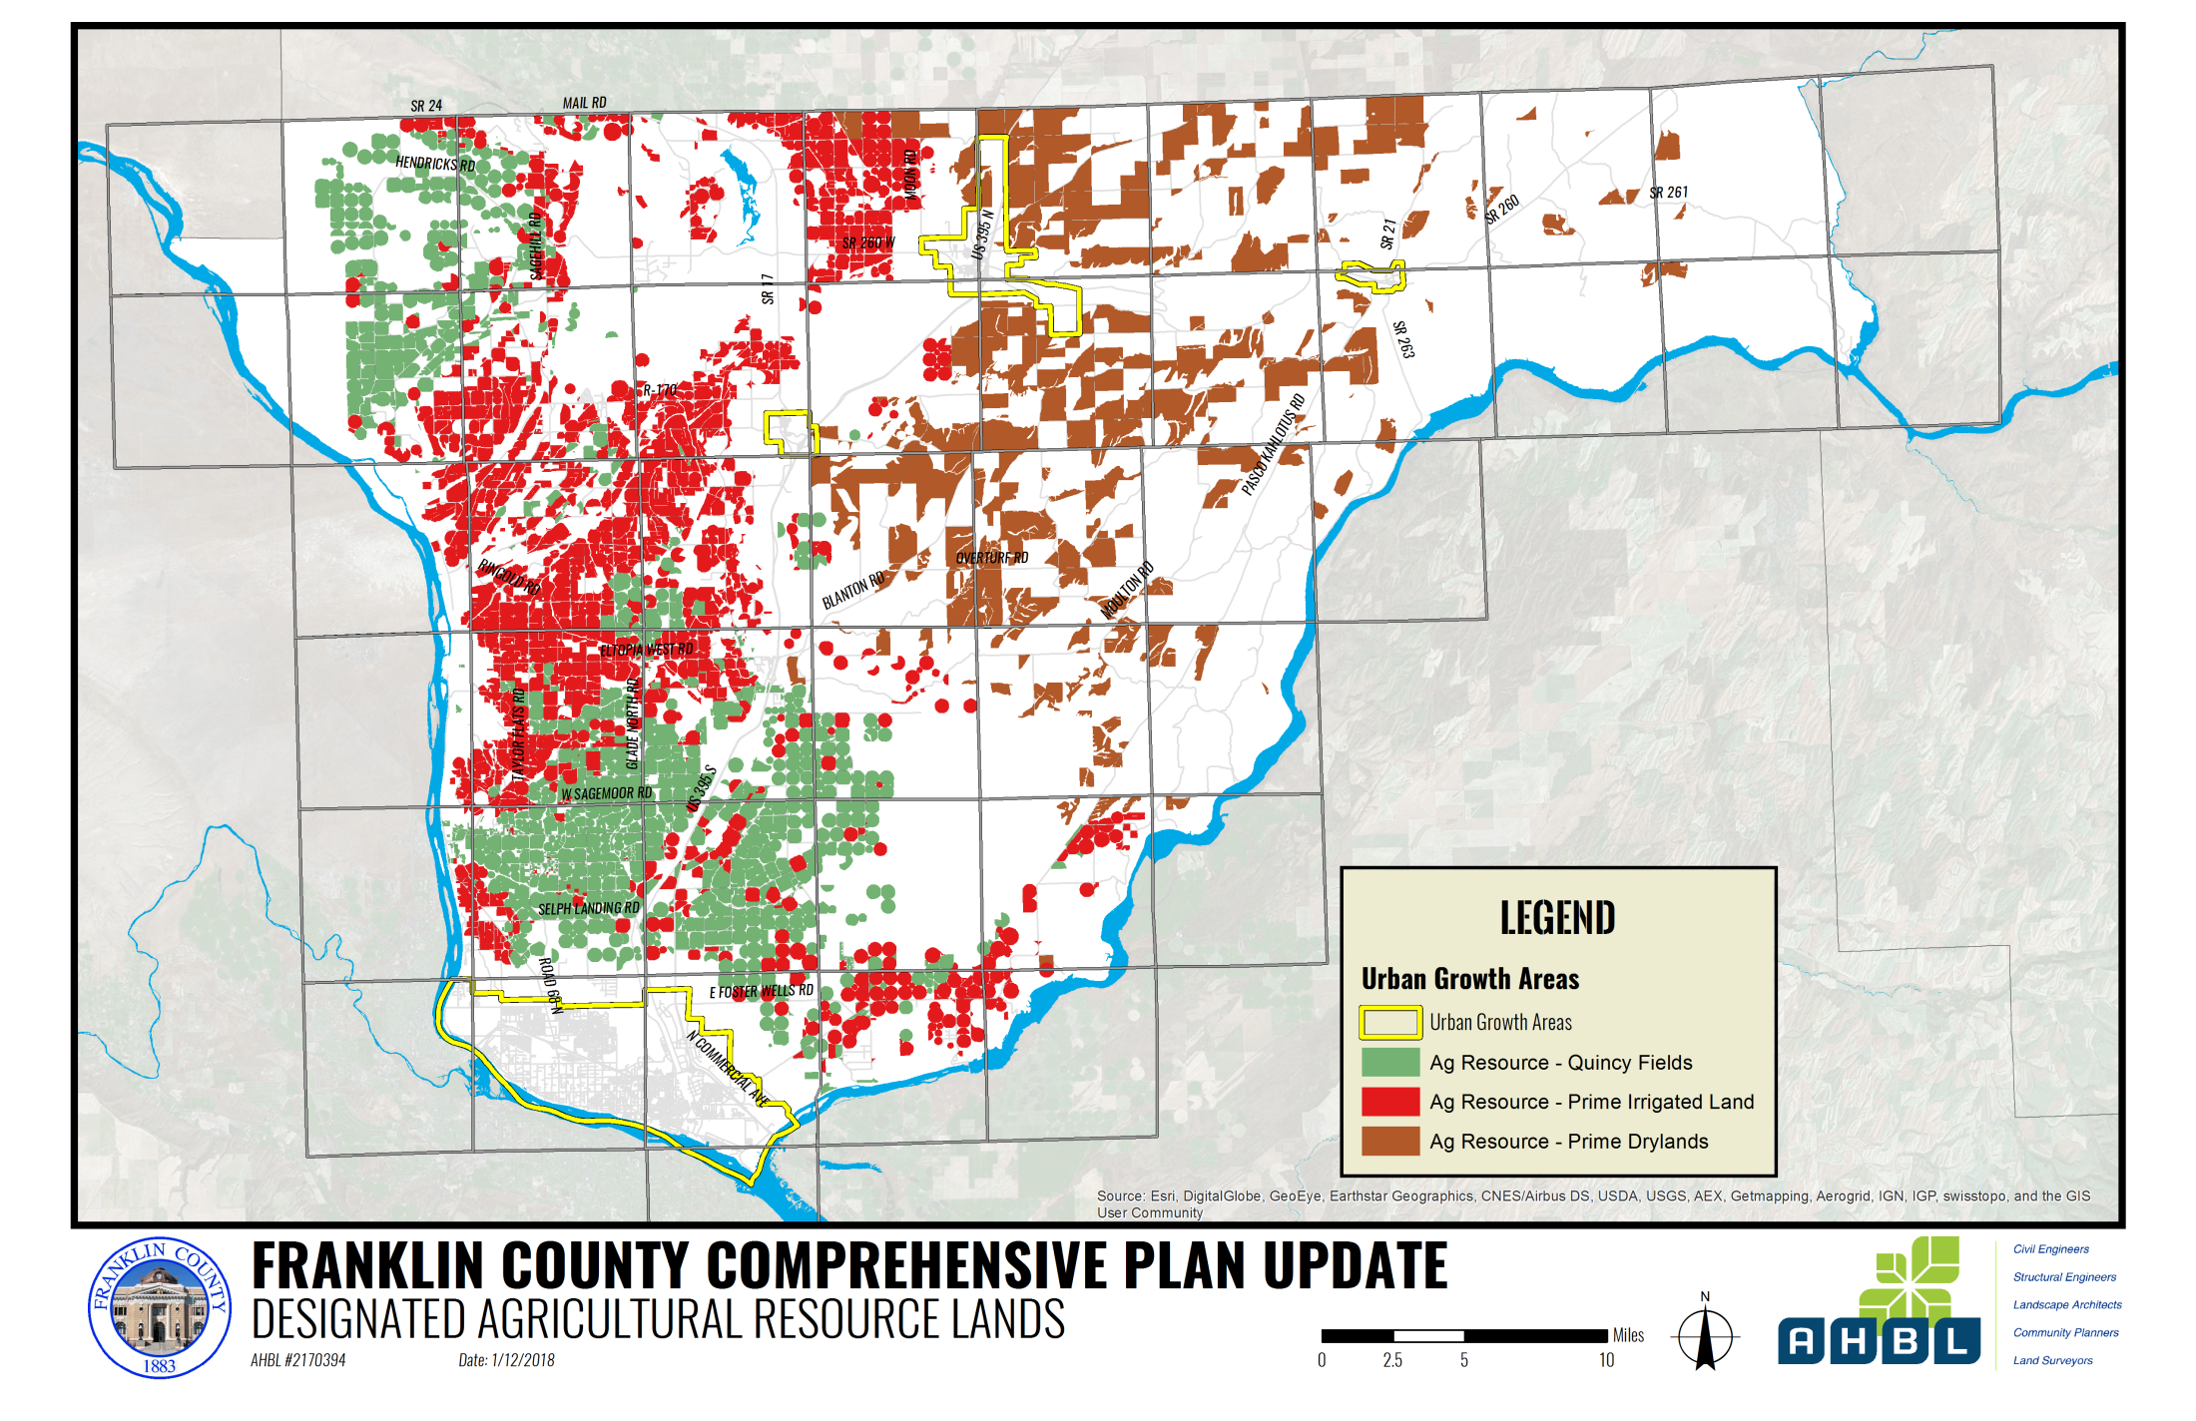
Franklin County Comprehensive Plan

Slide 13
Guidance: Planning UGAs
URBAN SERVICES
WAC 365‐196‐320 Providing urban services
WAC 365‐196‐415 Capital facilities element
COSTS OF URBAN SERVICES
WAC 365‐196‐320(4) Level of financial certainty
TOOLS TO MANAGE UGAs
WAC 365‐196‐300 Urban density
WAC 365‐196‐330 Phasing development within the UGA
USING POPULATION PROJECTIONS
WAC 365‐196‐310(3) Urban growth areas
LAND CAPACITY & BUILDABLE LANDS
WAC 365‐196‐325 Providing sufficient land capacity suitable for development
WAC 365‐196‐315 Buildable lands review and evaluation
HOUSING MARKET CONDITIONS
WAC 365‐196‐410 Housing elements
IMPLEMENTATION/ MONITORING
WAC 365‐196‐600 Public participation
WAC 365‐196‐620 Integration of SEPA
WAC 365‐196‐650 Implementation strategy
WAC 365‐196‐800 Relationship between development regulations and comprehensive plan
Franklin County Comprehensive Plan

Slide 14
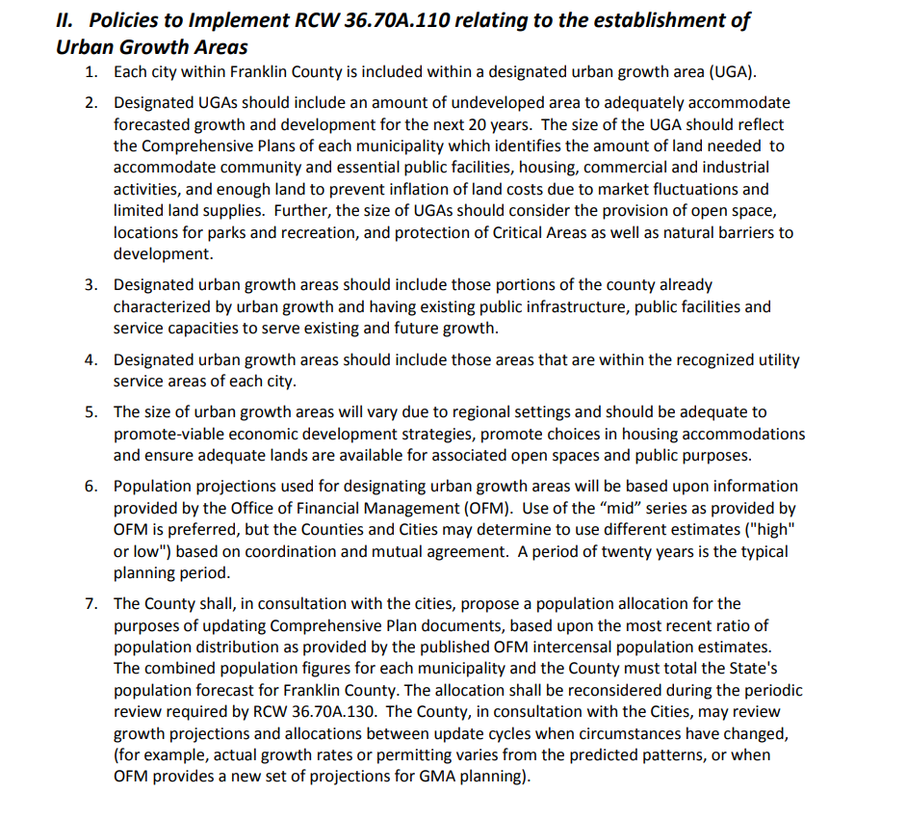
County wide planning policies
Franklin County Comprehensive Plan

Slide 15
LIMITED AREAS MORE INTENSIVE RURAL DEVELOPMENT
(LAMIRDs)

Slide 16
Franklin County Comprehensive Plan

Slide 17
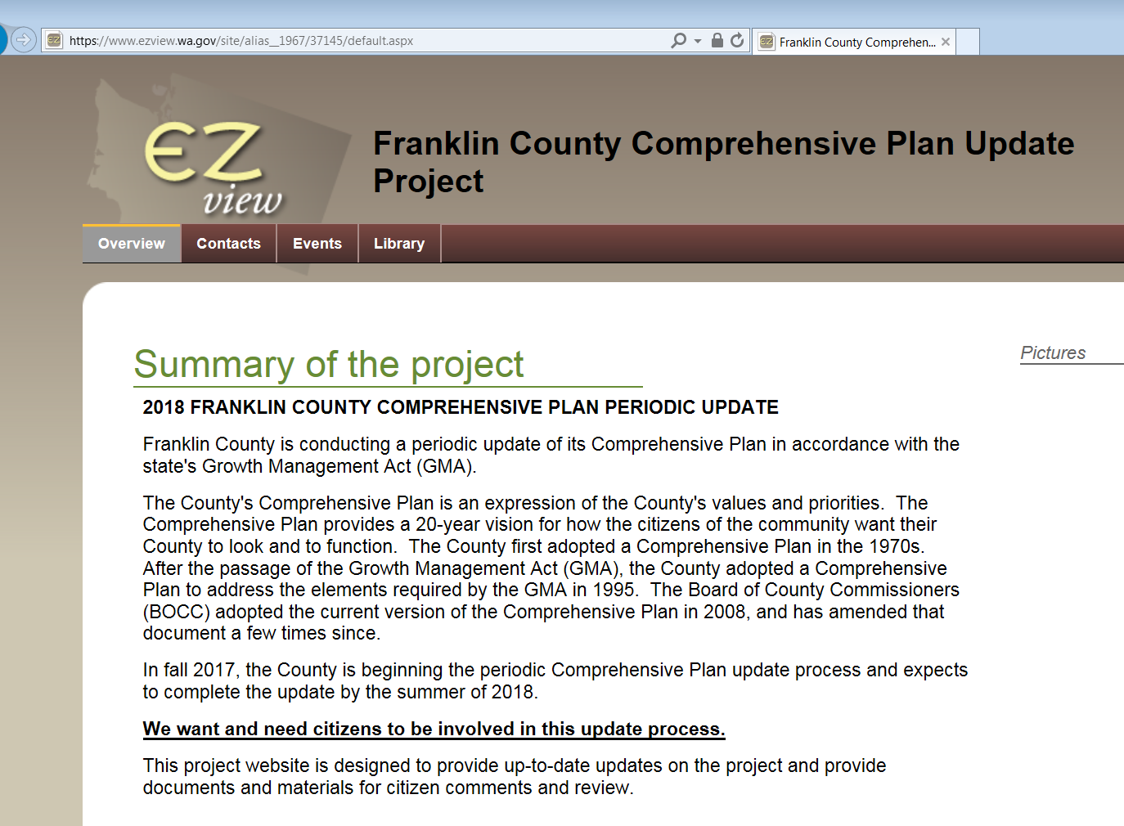
Questions?
Update Project Contacts:
Nicole Stickney, AHBL, Inc.: nstickney@ahbl.com
Website
www.bit.ly/FranklinPlan
Franklin County Comprehensive Plan

